Slide 1

HOSPITAL DATA ANALYSIS WITH POWER BI
GE19612 – PROFESSIONAL READINESS FOR INNOVATION,
EMPLOYABILITY AND ENTREPRENEURSHIP
Submitted by :
JEEVENA B S 2116210701091
KEERTHANA G 2116210701116
JOSHITA UMANATH 2116210701098
Supervisor :
Dr . K.Anand M.E.,Ph.D.,
Professor
Department of Computer Science and Engineering
Rajalakshmi Engineering College
Thandalam,
Chennai-602105.

Slide 2
ABSTRACT
• Massive hospital data (EHRs, billing, labs) holds the potential for better care, resource allocation, and efficiency.
• Power BI unlocks this potential by connecting to healthcare data and creating clear visualizations.
• User-friendly dashboards and reports make it easy to analyze trends and gain insights.
• This translates to better patient care, smarter resource use, and a more efficient healthcare system.

Slide 3
PROBLEM STATEMENT
Hospitals are drowning in data silos. Valuable information like patient trends, doctor schedules, and bed availability are trapped in separate systems, preventing a holistic view.
• The lack of a clear picture of bed occupancy makes it challenging to place patients effectively and allocate resources appropriately. In worst-case scenarios, this can lead to delays and bottlenecks in patient care.• Similarly, fragmented doctor scheduling data can confuse and extend patient wait times. Streamlining this information allows for better coordination and potentially shorter waiting periods.
• Most importantly, disconnected patient data makes it difficult for healthcare professionals to identify trends and patterns in care. This can hinder the ability to improve treatment regimens and ultimately patient outcomes.

Slide 4
AIM AND OBJECTIVES
Aim:
The main objective of this project is to create an intuitive Power BI dashboard in order to close the data gap that exists at the hospital. This dashboard will combine doctor scheduling, live bed availability, and anonymized patient data onto a single platform. The initiative gives hospital administration the tools they need to make data-driven choices by simplifying complicated data into understandable graphs and charts. In the end, this will enhance patient care by enabling more efficient use of resources, simpler care coordination, and shorter wait times.

Slide 5
LITERATURE SURVEY
There has been a lot of study in the field of algorithms for learning for its potential applications in healthcare because to the growth in behavioral health problems among individuals and the need for practical remedies. The exponential increase in mental illness and despair has impacted many people's lives, and a number of things need to change. An individual's mental stability may be impacted by several circumstances. Keeping in mind several elements such as age, gender, stress level, loneliness, depression severity, sleeplessness, and aggression, we will examine the key variables that contribute to poor mental health.
Data analytics has become a viable tool for solving problems in a number of related healthcare occupations. Knowledge mining is becoming more prevalent in a variety of industries and divisions as to its successful application in highly publicized fields like e-business, advertising, and retail. With the aid of predictive analysis, medical services firms can reduce their expenses while providing better care. Massive amounts of data also aid in reducing medication mistakes by enhancing the execution of regulations and budgets and lowering readmission rates. The goal of this study is to identify key disciplines to enhance patient engagement, health system management, diagnosis, and cost reduction. Data relating to patients will be carefully gathered and analyzed using Microsoft Power BI.

Slide 6
Hospital management may now better oversee everyday operations with the use of health information systems, which include key performance indicators (KPIs) for time-aggregated monitoring. However, there aren't many suggestions for productivity dashboards in the literature right now to help hospital stakeholders. The present study centers on two interconnected issues: (1) hospital organizations require productivity data to enhance service accessibility, and (2) managers require productivity data to maximize resource distribution. The creation of dashboards to track data gathered from a healthcare organization in order to assist decision-makers is the focus of this research. The Design Science Research (DSR) approach was used in the development and assessment of the productivity dashboard. Stakeholders from a big Portuguese hospital assessed the dashboard and helped iteratively improve its design to create a helpful decision support system.
These days, systems for managing healthcare are using a number of strategies that help evidence-based medicine reach its objectives. This study examines several visualization methods and their use in medical settings. We chose a few current papers on visualization methods in healthcare that were released between 2018 and 2021. Massive amounts of data are produced by the healthcare industry; in order to make the data easily understood and to direct its effective display, visualization techniques are needed. Using graphics, photos, and videos to effectively display information is known as visualization in the healthcare industry. Large data systems manage enormous volumes of data, which calls for visualization strategies to show the data in an understandable way.

Slide 7
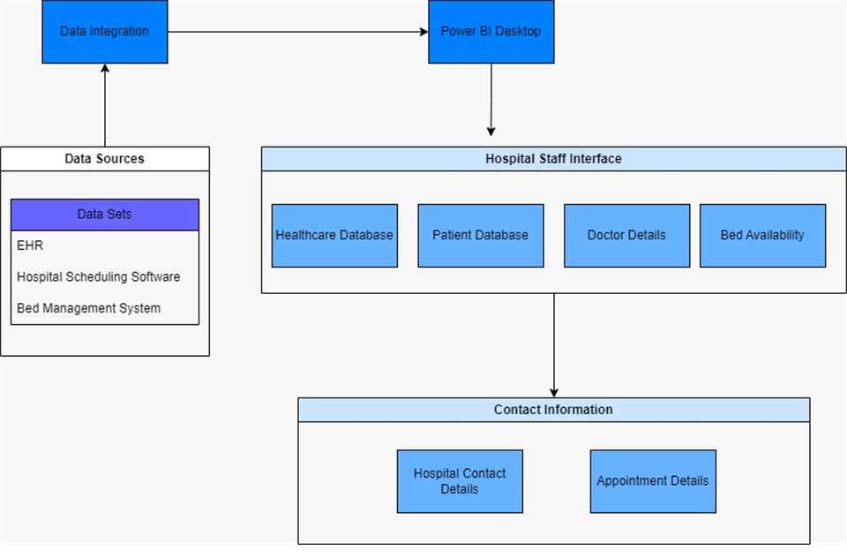
ARCHITECTURE DIAGRAM

Slide 8
Data Analysis Tool Used:
POWER BI
Why POWER BI?
Breaks Down Data Silos: Power BI connects to various healthcare data sources, uniting them into a single platform for easy analysis.
Makes Data Visual: Power BI transforms complex healthcare data into clear and understandable charts and graphs.
Improves Decision Making: User-friendly dashboards with insights help healthcare workers make informed decisions about patient care and resource allocation.
Boosts Efficiency: Power BI streamlines operations by providing real-time data on bed occupancy, doctor schedules, and patient trends.

Slide 9
HOSPITAL DATA MANAGEMENT
How It Works?
Unifies Data Landscape: Power BI acts as a central hub, consolidating healthcare data from disparate sources like EHRs, billing systems, and bed management tools.
Transforms Insights: Power BI simplifies complex medical data, converting it into clear and actionable visualizations for improved comprehension.
Empowers Through Dashboards: User-friendly dashboards become the go-to platform for healthcare professionals, providing real-time insights on patient trends, resource allocation, and wait times.
Data-Driven Decision Making: Power BI empowers informed choices by hospital administrators. They can optimize bed allocation, streamline staff scheduling, and improve patient flow based on visualized data.

Slide 10
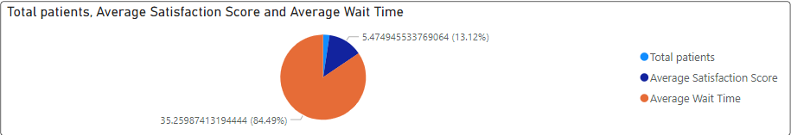
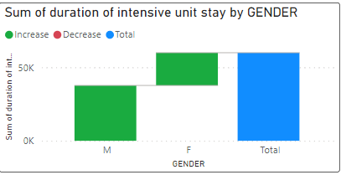
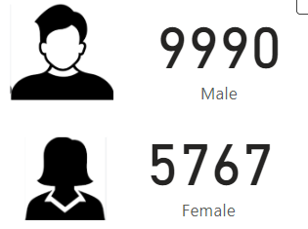
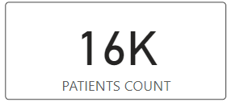
MODULE DESCRIPTION
Hospital Database:
This page is right after the Home Page.
This page in Power BI consists of the entire hospital database being represented visually and organizing the data.
It consists the information about Total patients, Total Male and Total Female.
It shows various graph representations of the data so that the analysis of the data will be made easier.

Slide 11
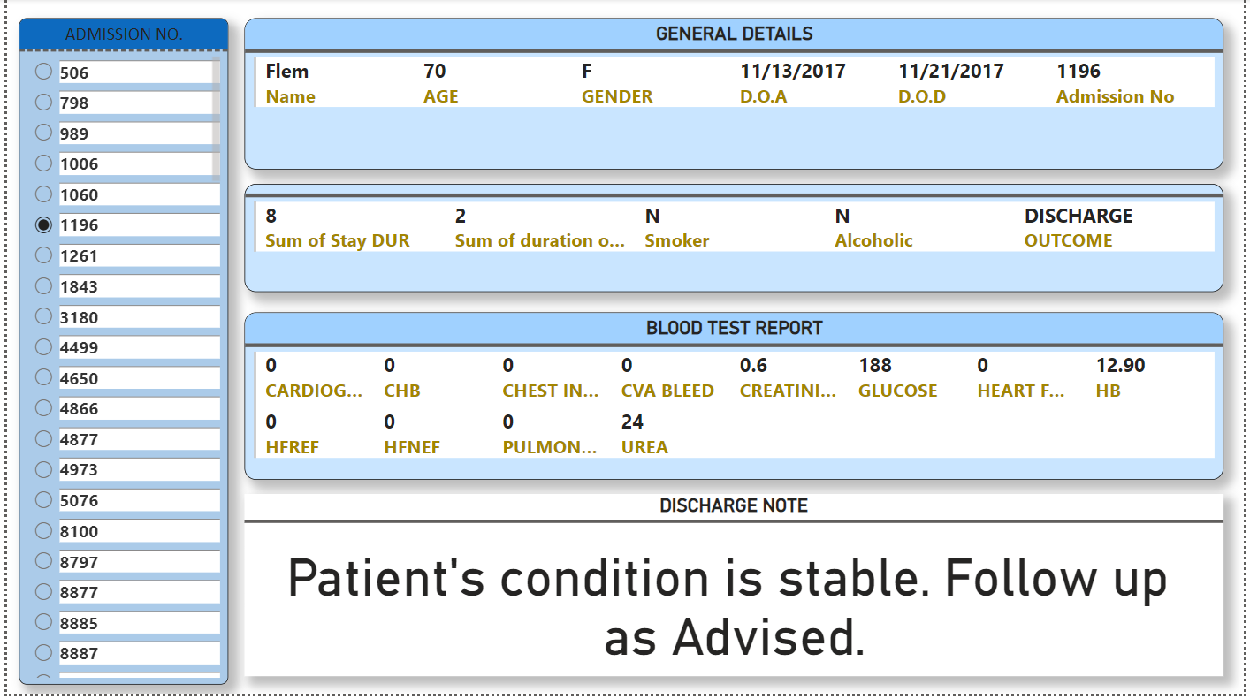
MODULE DESCRIPTION
Patient Database:
The Patient is the page that is right after the Hospital Database.
This page consists of the entire general database of every individual patients in the healthcare.
These general information include Name, Age, Gender, D.O.A, D.O.D, Admin no and many more precise data regarding their overall health.

Slide 12
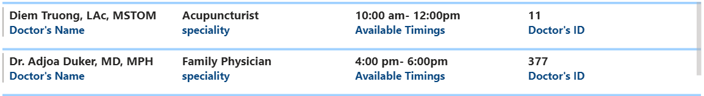
MODULE DESCRIPTION
Doctor Database :
The next following page will be the Doctor Database.
This page is where the entire database of the doctors working in the hospital is present .
The Database include the doctors name, there specialized field, the working hours and their Doctors ID.

Slide 13
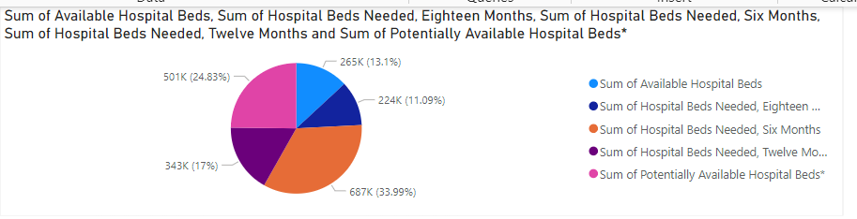
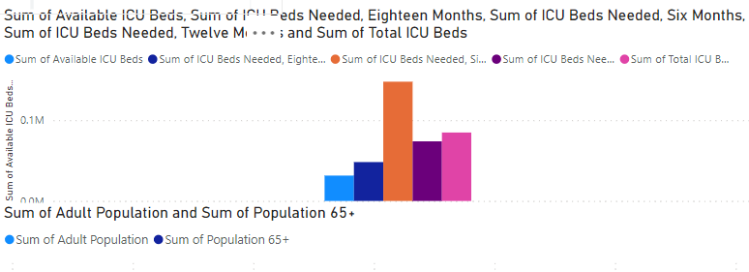
MODULE DESCRIPTION
BED ALLOCATION:
The "Bed Availability" display makes it easy to see how many hospital beds are available.
The two primary metrics that are displayed are the total number of beds required and the total number of beds available.
These figures provide a quick summary of the hospital's capacity at any one time.

Slide 14
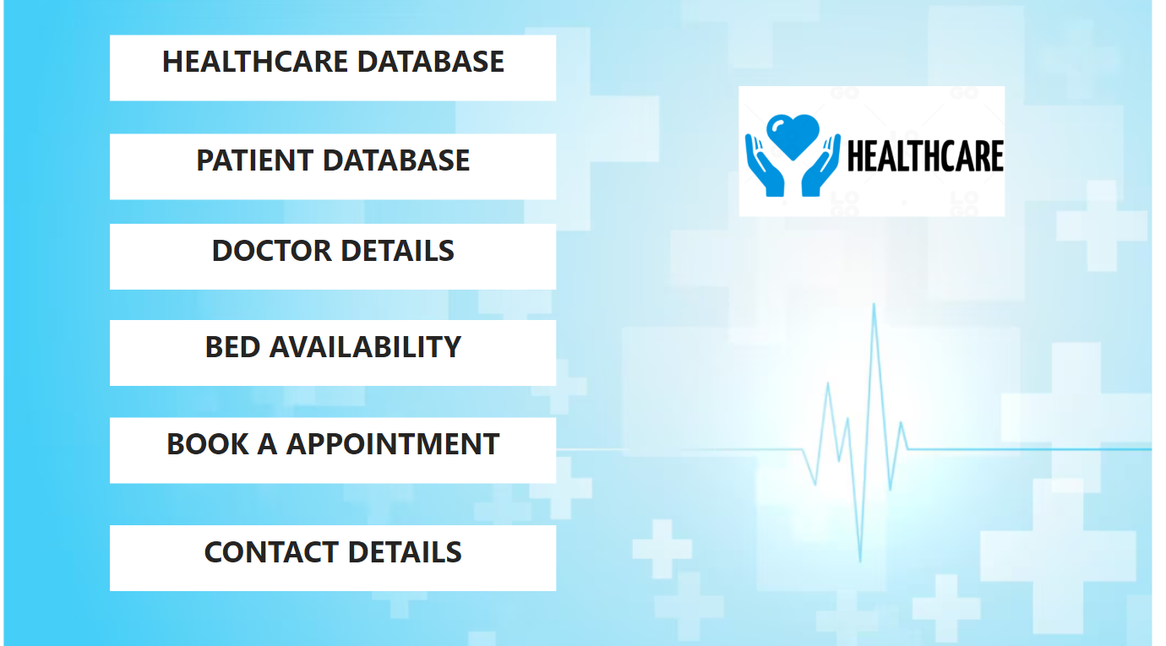
RESULTS
HOME PAGE

Slide 15
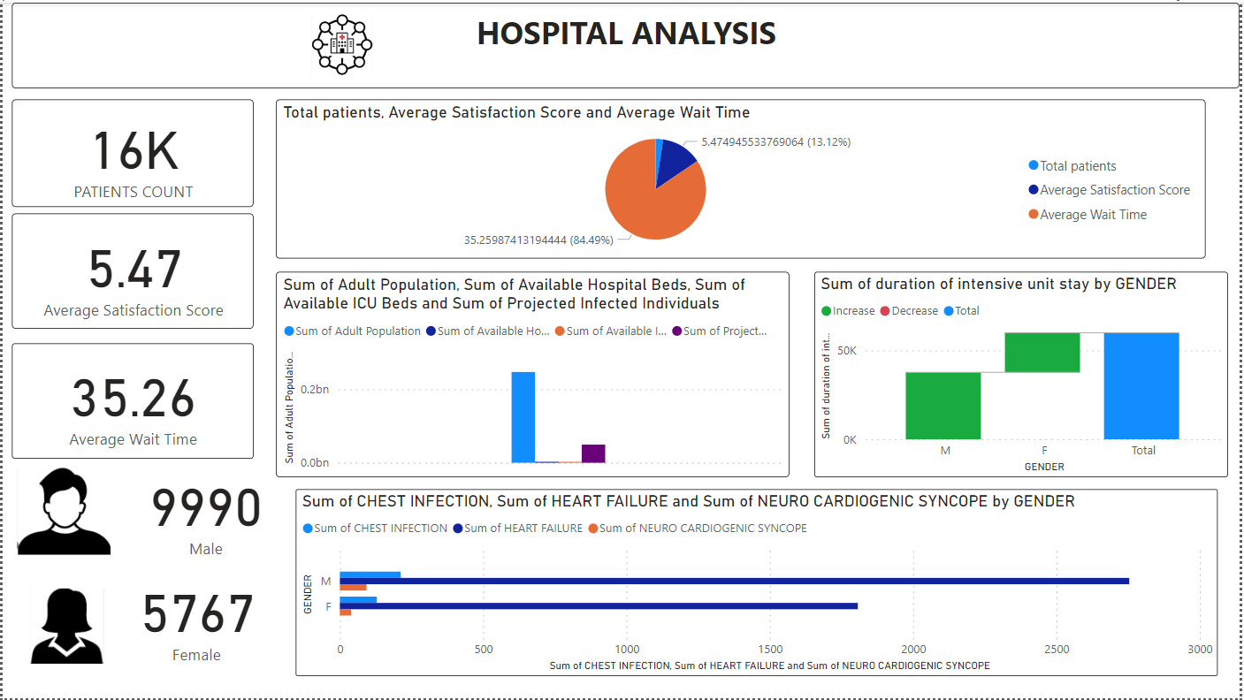
RESULTS
Hospital Analysis

Slide 16
RESULTS
Patient Database

Slide 17
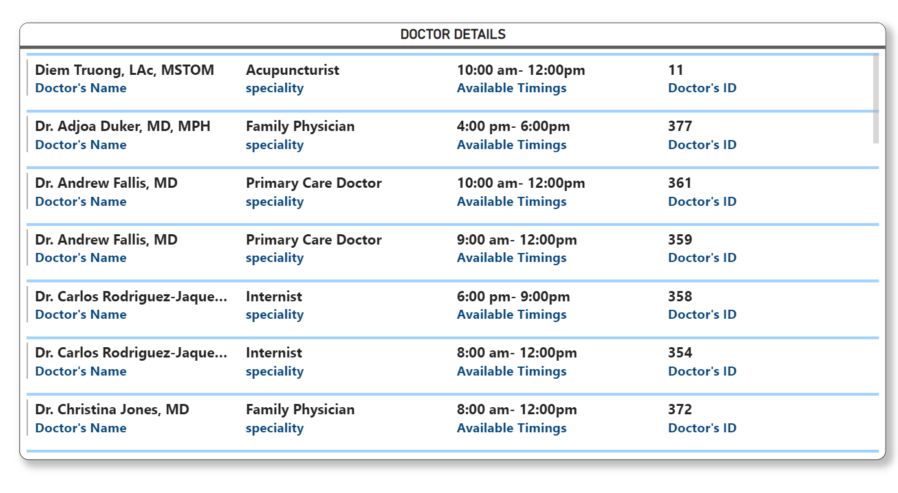
RESULTS
Doctor Database

Slide 18
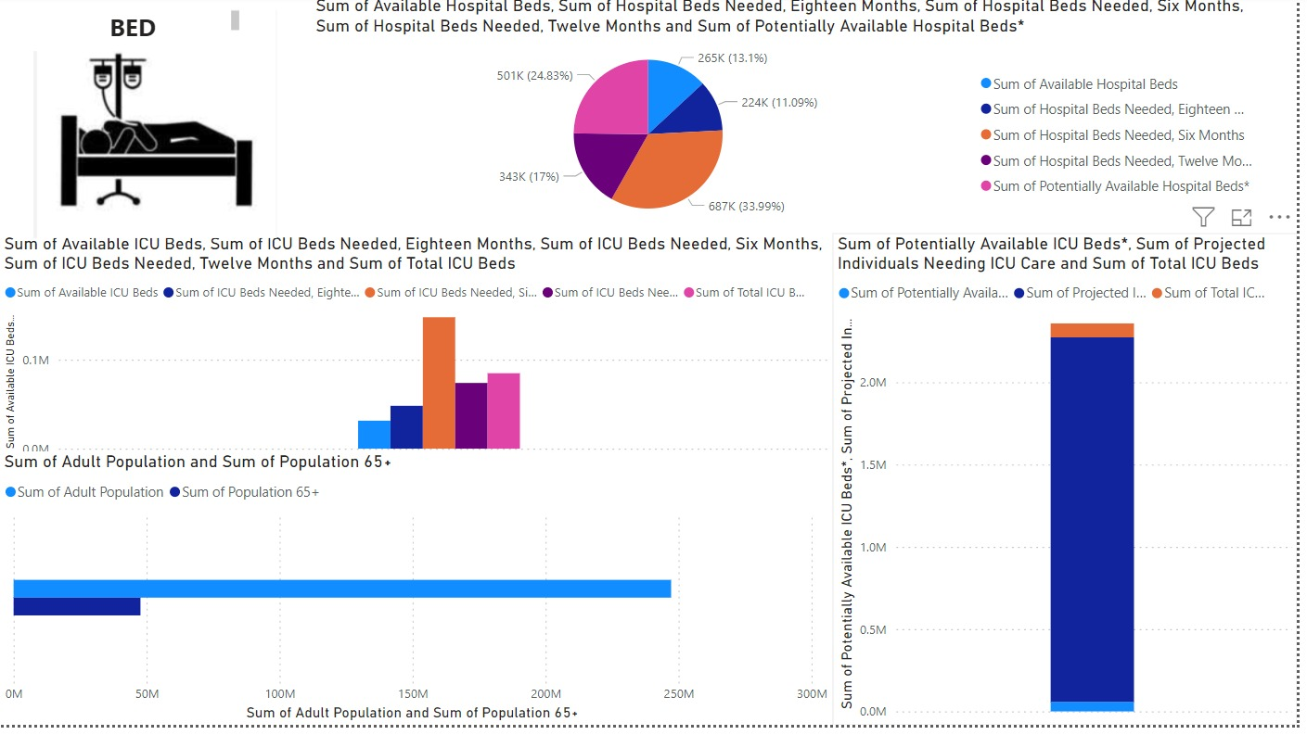
RESULTS
Bed Allocation

Slide 19
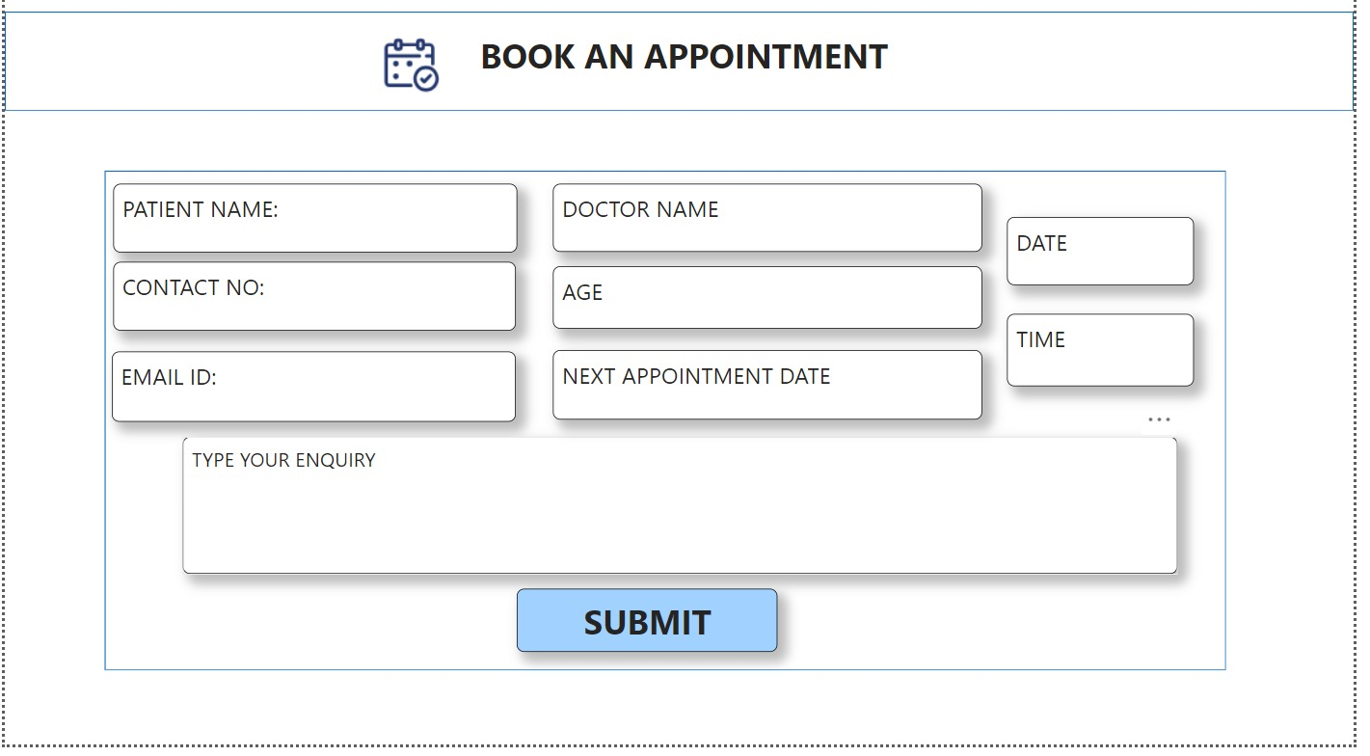
RESULTS

Slide 20
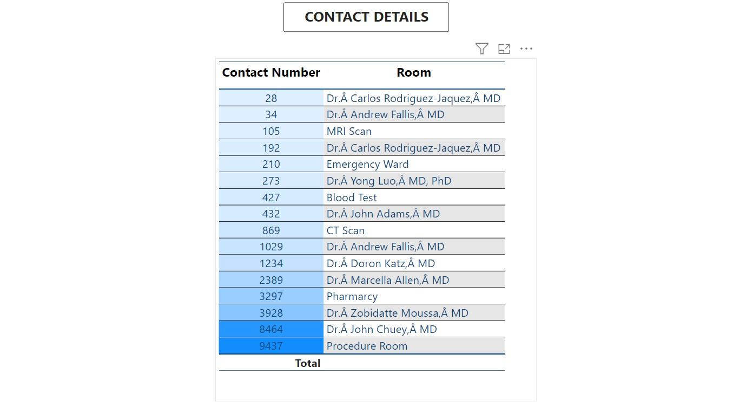
RESULTS

Slide 21
CONCLUSION
Power BI dashboards transformed hospital operations in this project (under 150 words). Anonymized patient data drives better care decisions. Key features include:
Emergency contact dashboard for faster response.
Doctor schedule dashboard for optimized scheduling. Real-time bed availability for efficient placement. Patient appointment request dashboard (potential streamlining).
These interconnected dashboards empower staff, improve resource allocation, and enhance the patient experience, leading to a more efficient healthcare system.

Slide 22
REFERENCES
Github link:
https://github.com/Joshita98/210701098-CS19621-PRIEE
References:
https://www.sciencedirect.com/science/article/pii/S2666603022000069
https://www.taylorfrancis.com/chapters/edit/10.1201/9781003185246-10/healthcare-data-analytics-using-business-intelligence-tool-annapurani-poovammal-ruvinga-ibrahim-venkat
https://www.researchgate.net/publication/356809684_An_Automated_Dashboard_to_Improve_Laboratory_COVID-19_Diagnostics_Management

Slide 23
Thank You

